Slide 1


Deep Learning (DL)
Lab1
Neural Network (NN)

Slide 2
Content
Neural Network | 1
Convolutional Neural Network (CNN) | 2
Transfer Learning of CNN | 3
NLP With ML | 4
RNN, LSTM GRU , Bidirectional LSTM Classification | 5
Recommendation System | 6
Speech Recognition | 7
Seq2Seq (Translation) | 8
Auto-Encoder | 9
GAN | 10
5 Marks | Attend
20 Mark | Tasks
5 Marks | Practical
30 Mark | Total

Slide 3
Agenda
Neural Network Components
Activation Functions
Loss Function
Optimization
Example of NN

Slide 4
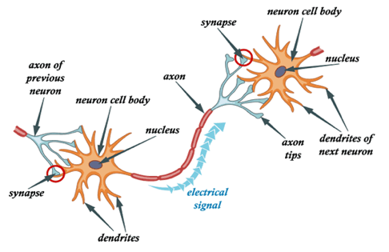
Human Brain Network
• The brain is composed of neurons linked together by synapses.
• Human brain has ~10^11 neurons ≈ number of trees in the amazon forest.
• The number of synapses ≈ number of tree leaves in the amazon forest.

Slide 5
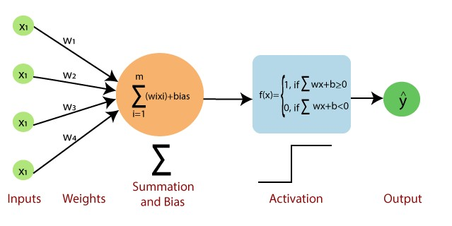
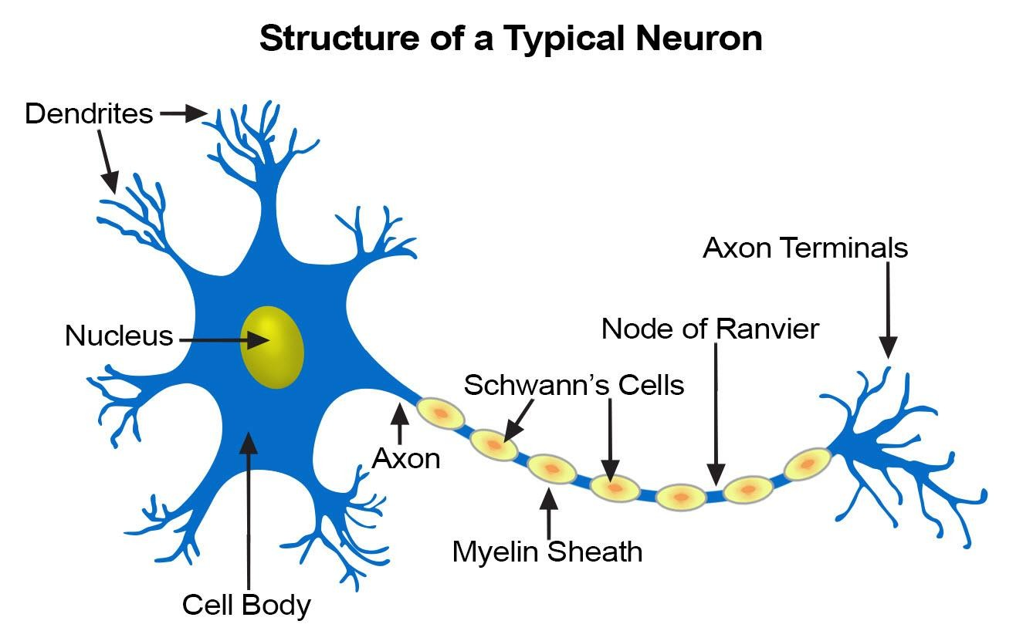
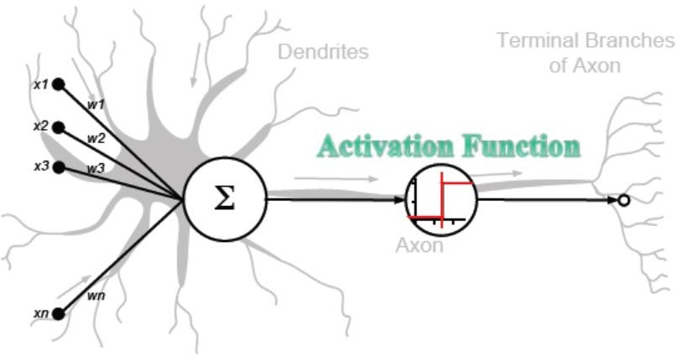
Human Brain Network and DL
4
March 20, 2022

Slide 6
Neural Network Components
• Layers
• Neurons
• Weights
• Bias
• Activation Functions

Slide 7
Layers
are used to hold neurons and pass it to subsequent layers

Slide 8
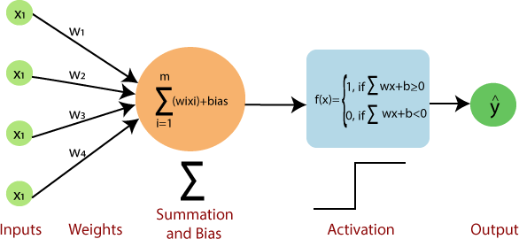
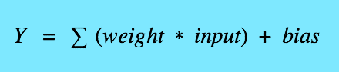
Neurons
it is a mathematical operation, it takes input data multiplied by weights and pass the sum through an activation functions to other neurons

Slide 9
Weights
First they are chosen random at the beginning of training and then it optimized to reduce loss during training

Slide 10
Bias
•Bias is just like an intercept added in a linear equation
•output = sum (weights * inputs) + bias
•There is only one bias per neuron
•There is a vector of bias per layer
•Bias is a constant which helps the model in a way that it can fit best for the given data.

Slide 11
Activation Functions
• It’s a function that we use to get the output of node.
• It is also known as Transfer Function.
•The purpose of the activation function is to introduce non-linearity into the output of a neuron.
•Activation function also helps to normalize the output of any input in the range between 0 to 1 or 1 to -1 or any values according to activation function.

Slide 12
Why Activation Functions?
Without activation function, weight and bias would only have a linear transformation, or neural network is just a linear regression model, a linear equation is polynomial of one degree only which is simple to solve but limited in terms of ability to solve complex problems or higher degree polynomials.

Slide 13
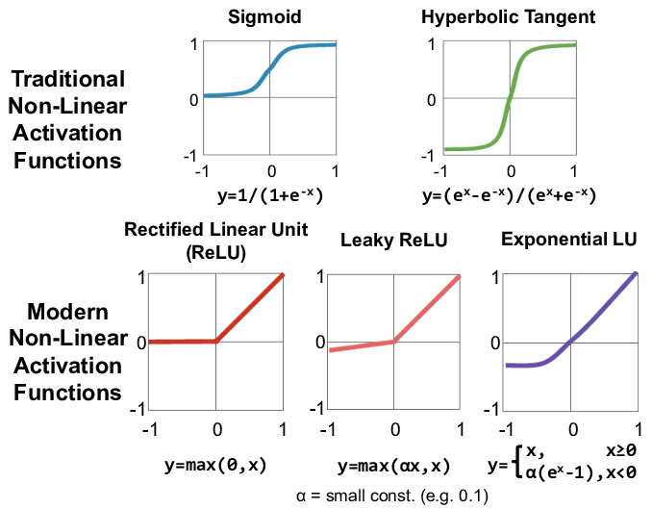
Type Of Activation Functions
Tanh

Slide 14
SOFTMAX Activation Function

Slide 15
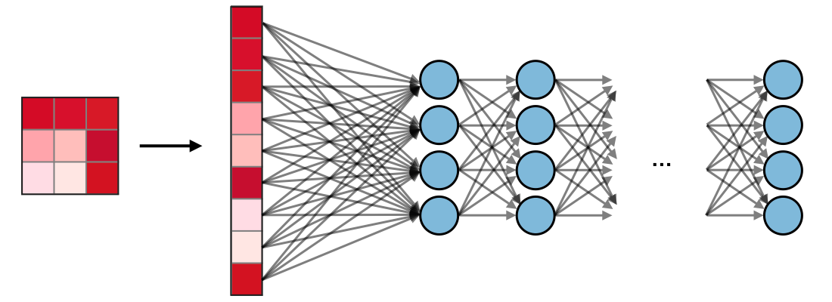
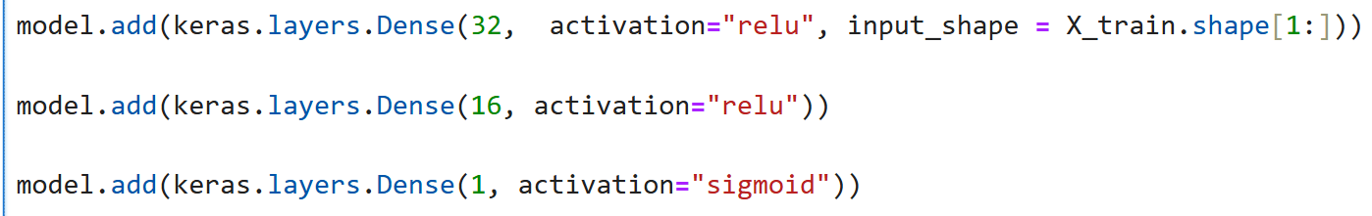
Dense Layer
Each input is connected to all neurons. If present, FC layers are usually found towards the end of model and can be used to optimize objectives such as class scores.

Slide 16
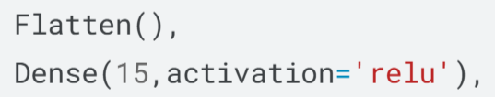
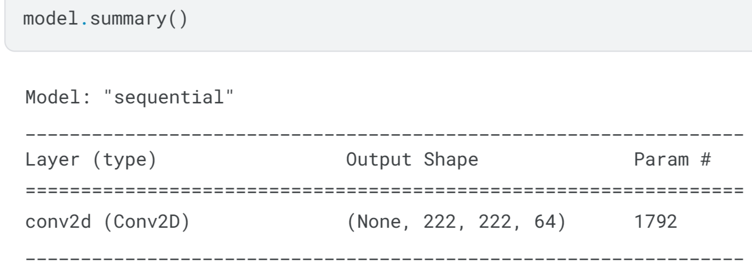
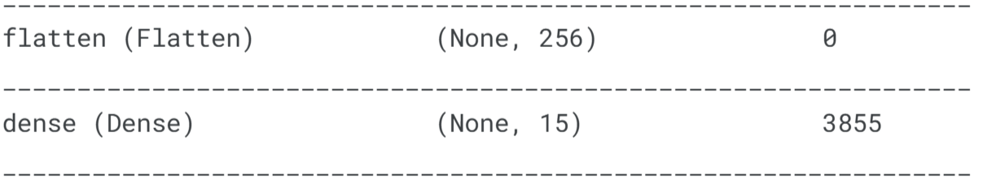
Model Summary

Slide 17
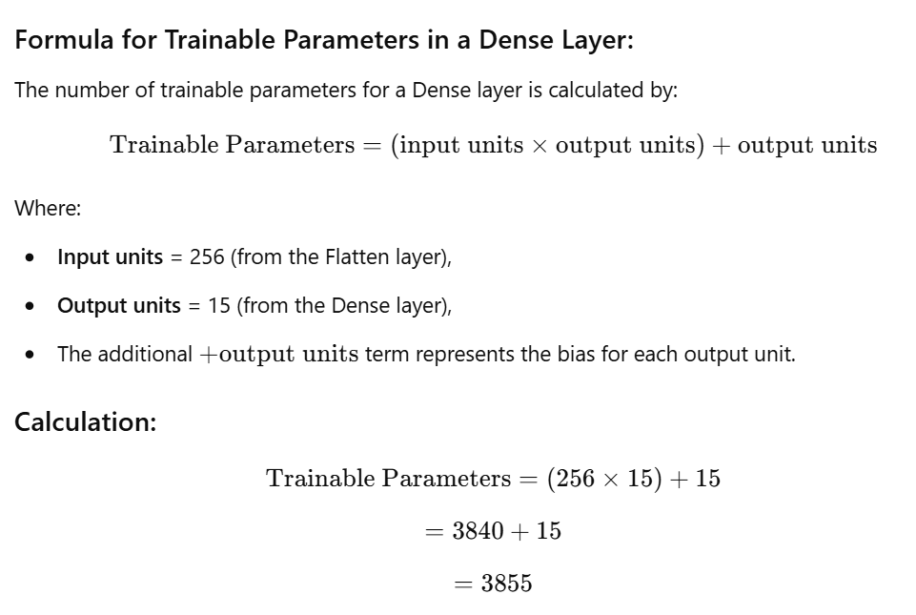
Calculate the number of trainable parameters in a Conv2D layer

Slide 18
Loss Functions
• Regression Loss Functions
– Mean Squared Error Loss
– Mean Absolute Error Loss
• Binary Classification Loss Functions
– Binary Cross-Entropy
• Multi-Class Classification Loss Functions
– Multi-Class Cross-Entropy Loss
– Sparse Multiclass Cross-Entropy Loss

Slide 19
• Regression Loss Functions
– Mean Squared Error Loss
– Mean Absolute Error Loss
Mean Squared Error [ MSE ]
Mean Absolute Error Loss

Slide 20
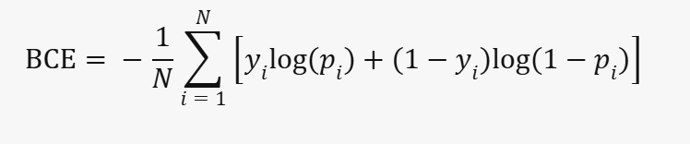
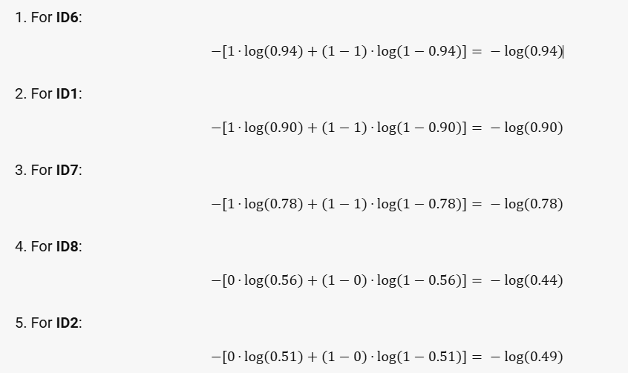
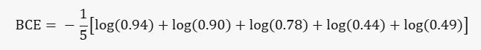
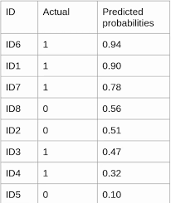
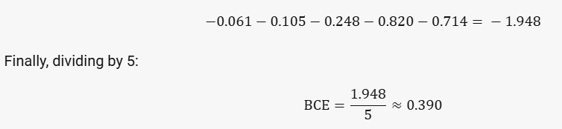
Binary Cross-entropy

Slide 21
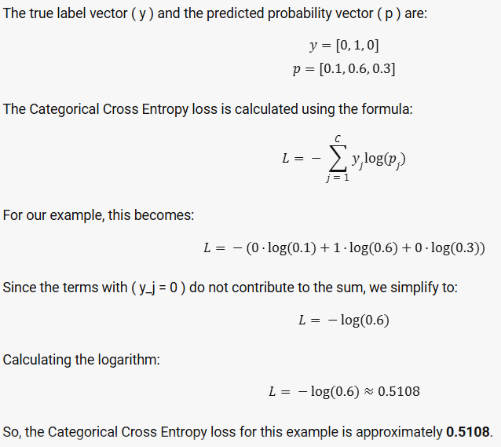
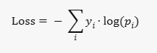
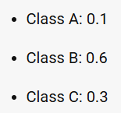
Categorical Cross Entropy

Slide 22
Optimizers
Optimizers are algorithms or methods used to minimize an error function (loss function) or to maximize the efficiency of production.
Optimizers are mathematical functions which are dependent on model’s learnable parameters i.e. Weights & Biases.
Optimizers help to know how to change weights and learning rate of neural network to reduce the losses.

Slide 23
Types Of Optimizers
• Gradient Descent
• Batch Gradient Descent
• Stochastic Gradient Descent
• Adagrad
• Rmsprop
• Adam

Slide 24
Gradient Descent
Gradient descent: is an optimization algorithm used to minimize some function by iteratively moving in the direction of steepest descent as defined by the negative of the gradient.
In machine learning, we use gradient descent to update the parameters of our model. Parameters refer to weights in neural networks.
To put it simply, we use gradient descent to minimize the cost function, J(w).
Very Slow

Slide 25
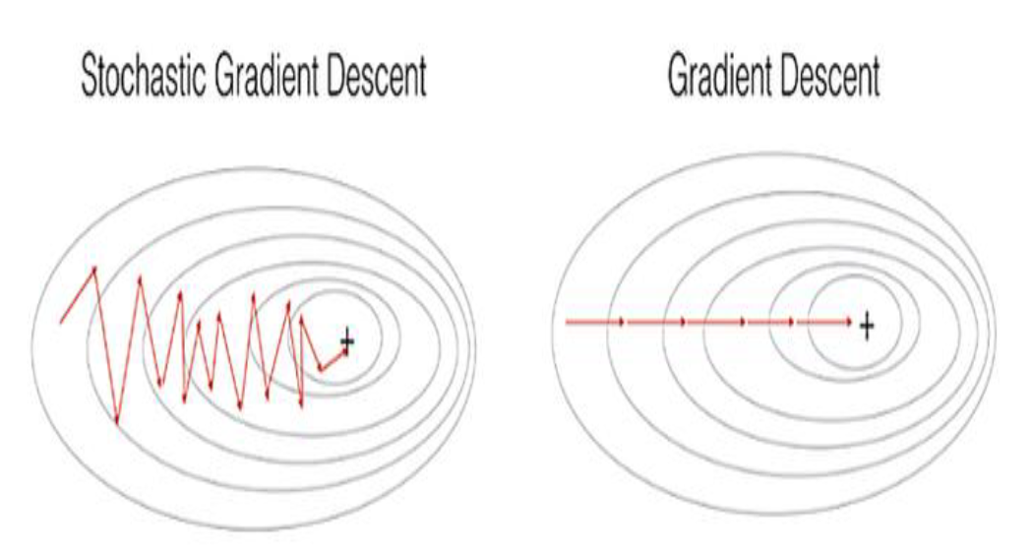
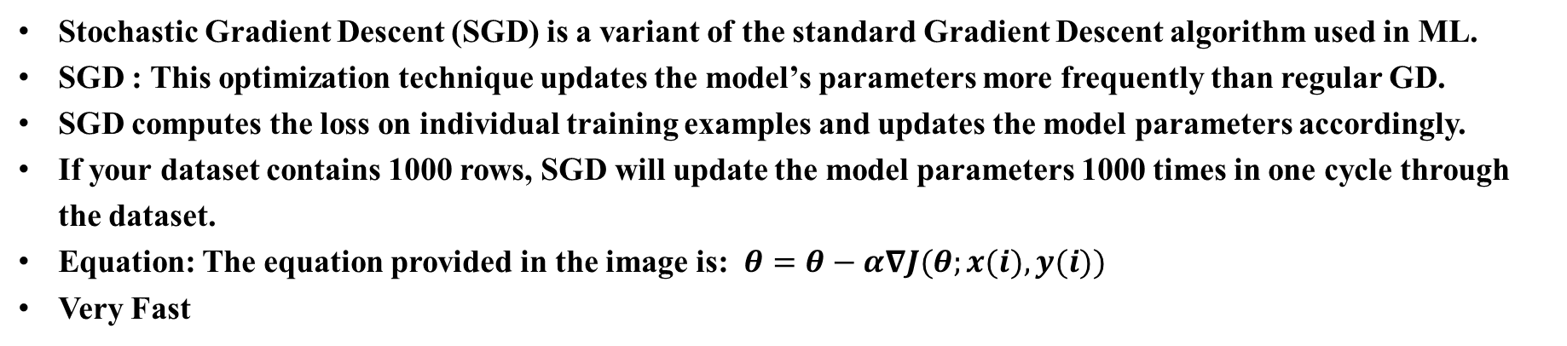
Stochastic Gradient Descent (SGD)
Stochastic Gradient Descent (SGD) is a variant of the standard Gradient Descent algorithm used in ML.
SGD : This optimization technique updates the model’s parameters more frequently than regular GD.
SGD computes the loss on individual training examples and updates the model parameters accordingly.
If your dataset contains 1000 rows, SGD will update the model parameters 1000 times in one cycle through the dataset.
Equation: The equation provided in the image is:$θ=θ−α∇J(θ;x(i),y(i))$
Very Fast

Slide 26
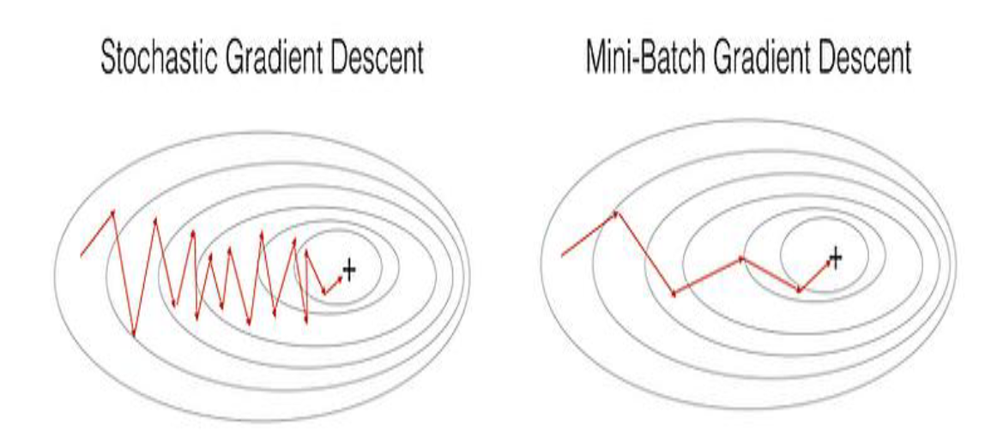
Mini-Batch Gradient Descent
Mini-Batch Gradient Descent, which is an optimization technique used in machine learning.
It is considered the best among all variations of gradient descent algorithms.
An improvement over both stochastic gradient descent (SGD) and standard gradient descent.
Updates model parameters after every batch of training examples.
Faster Than Gradient Descent but Slower Than Stochastic Gradient Descent

Slide 27
Learning Rate
How big/small the steps are gradient descent takes into the direction of the local minimum are determined by the learning rate, which figures out how fast or slow we will move towards the optimal weights.

Slide 28
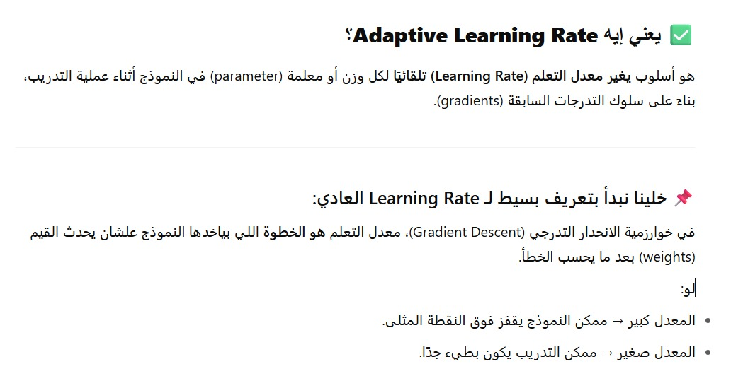
Adaptive Learning Rate

Slide 29
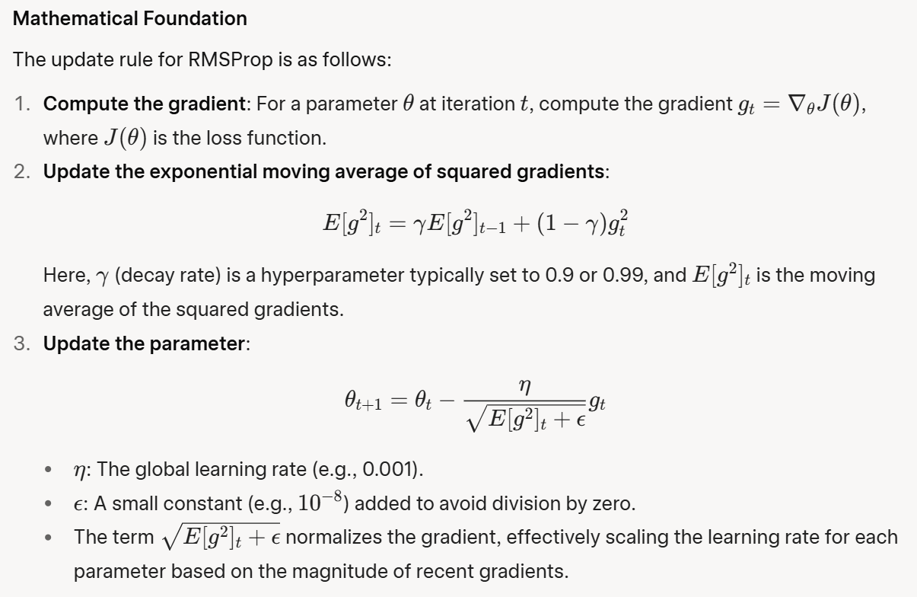
RMSProp (Root Mean Square Propagation)
Definition
RMSProp is an adaptive learning rate optimization algorithm designed to address some limitations of Adagrad, particularly its aggressive learning rate decay.
Instead of using the cumulative sum of squared gradients (as in Adagrad), RMSProp uses an exponential moving average (EMA) of squared gradients to scale the learning rate for each parameter.
This makes it more suitable for non-convex problems, such as training deep neural networks.

Slide 30
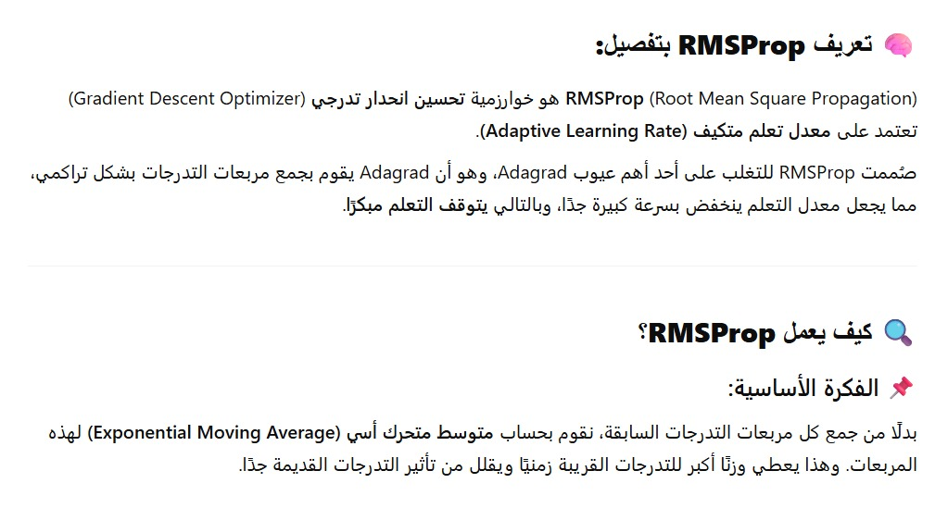
RMSProp (Root Mean Square Propagation)

Slide 31
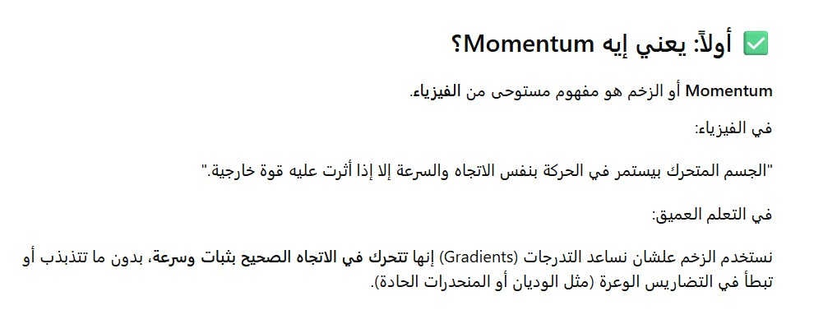
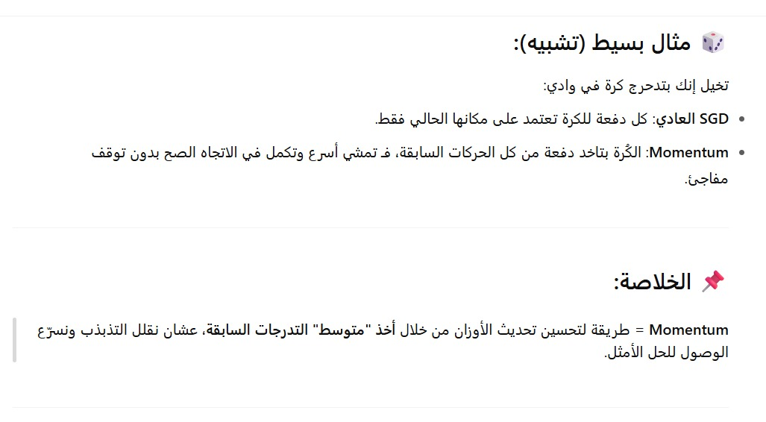
Momentum

Slide 32
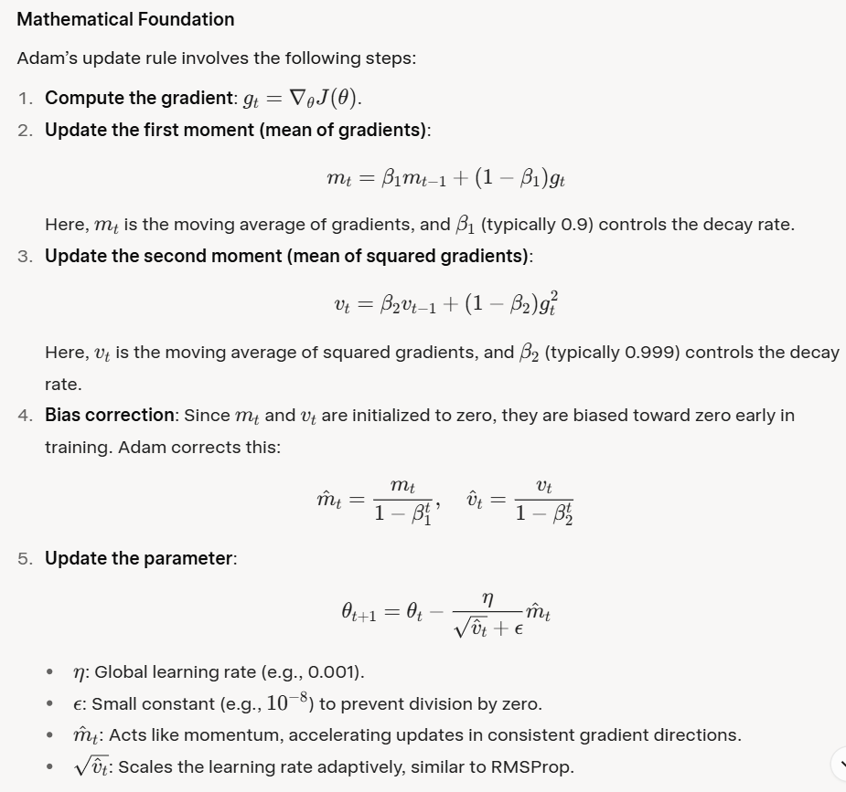
Adam (Adaptive Moment Estimation)
Definition
Adam is one of the most widely used optimization algorithms in deep learning,
It combines the benefits of momentum (from SGD with momentum) and adaptive learning rates (from RMSProp and AdaDelta).
Adam uses two moving averages:
one for the gradients (first moment, or mean) and
one for the squared gradients (second moment, or uncentered variance).
This allows Adam to accelerate gradient descent while adapting the learning rate for each parameter.

Slide 33
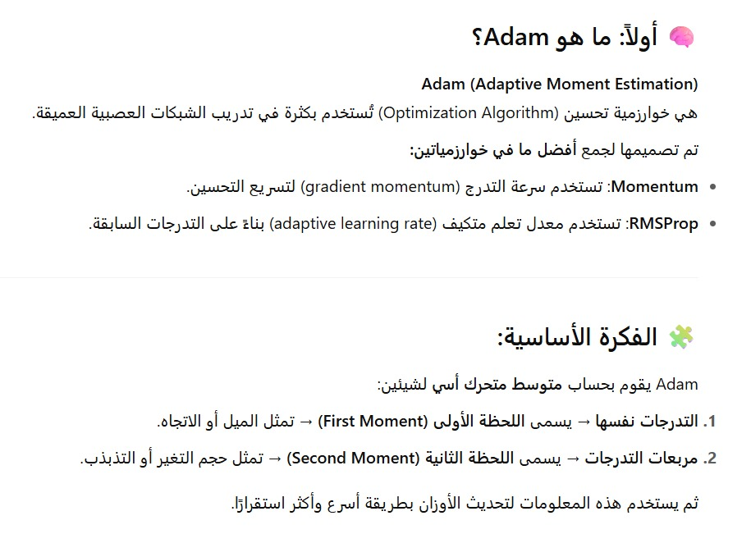
Adam (Adaptive Moment Estimation)

Slide 34
Feedforward and Backpropagation
Feedforward
In a feedforward neural network, information flows in one direction—from the input layer, through any hidden layers, to the output layer.
It processes input data to produce an output. Each layer transforms the input data using weights and activation functions, passing the result to the next layer.
Backpropagation
Backpropagation is an algorithm used to train feedforward neural networks.
Backpropagation is the training method that optimizes the network’s performance by updating its parameters.
It updating the weights and biases of the network to minimize the error between the predicted output and the actual target values.

Slide 35
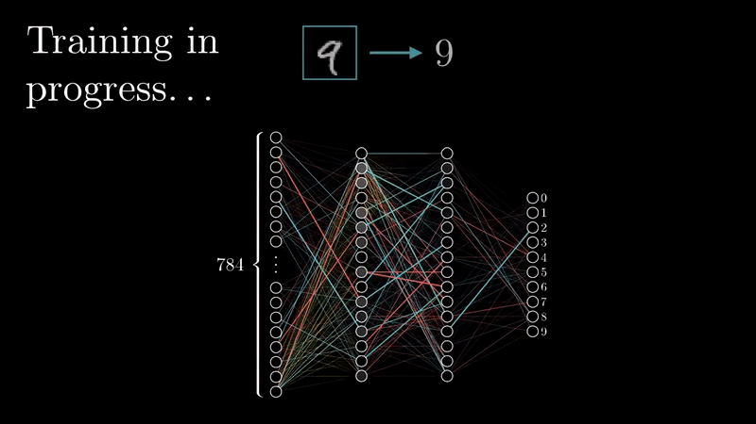
Feedforward and Backpropagation

Slide 36
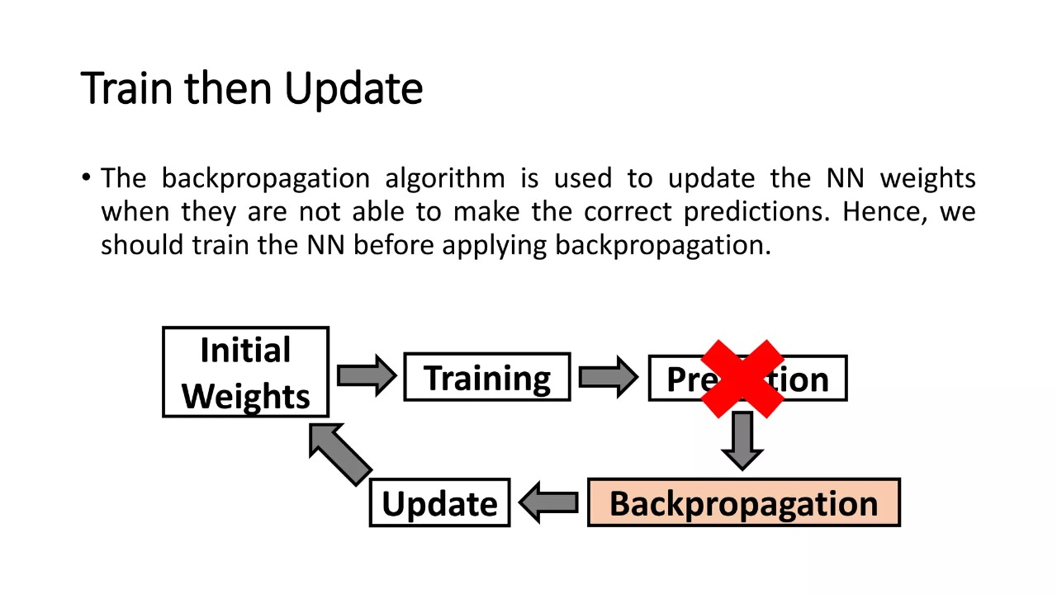

Slide 37
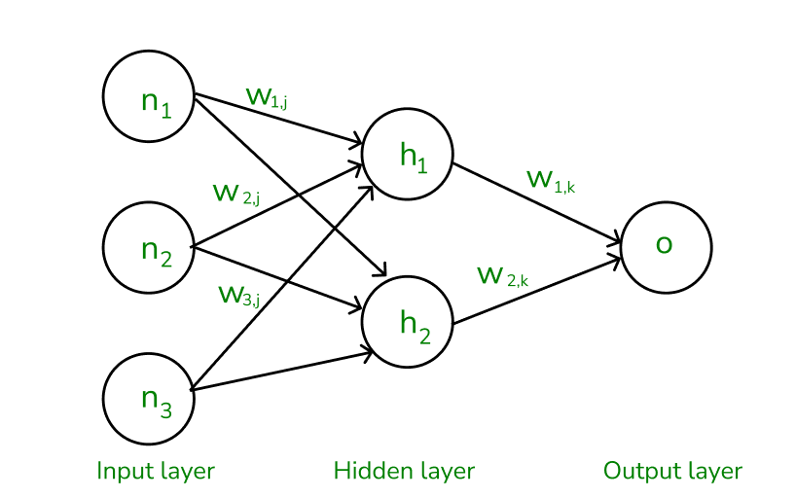
Example of NN

Slide 38
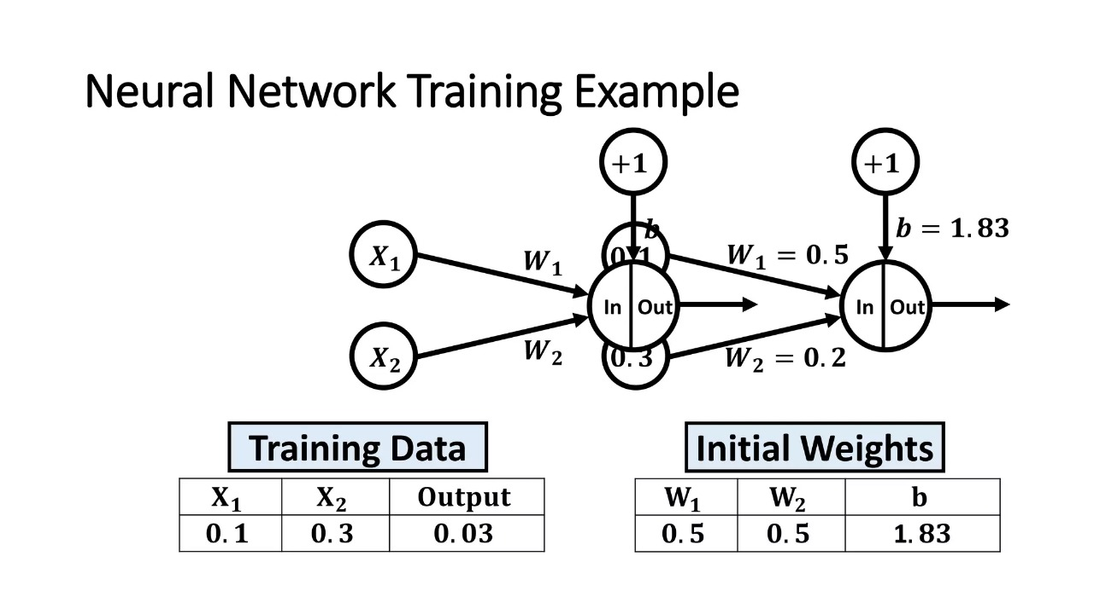
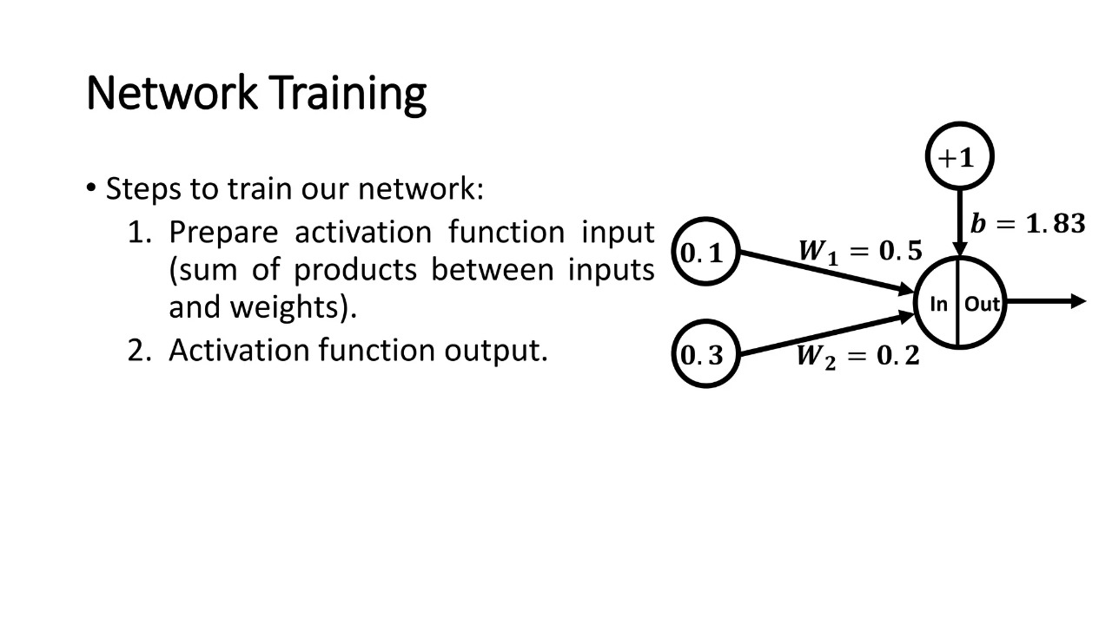

Slide 40
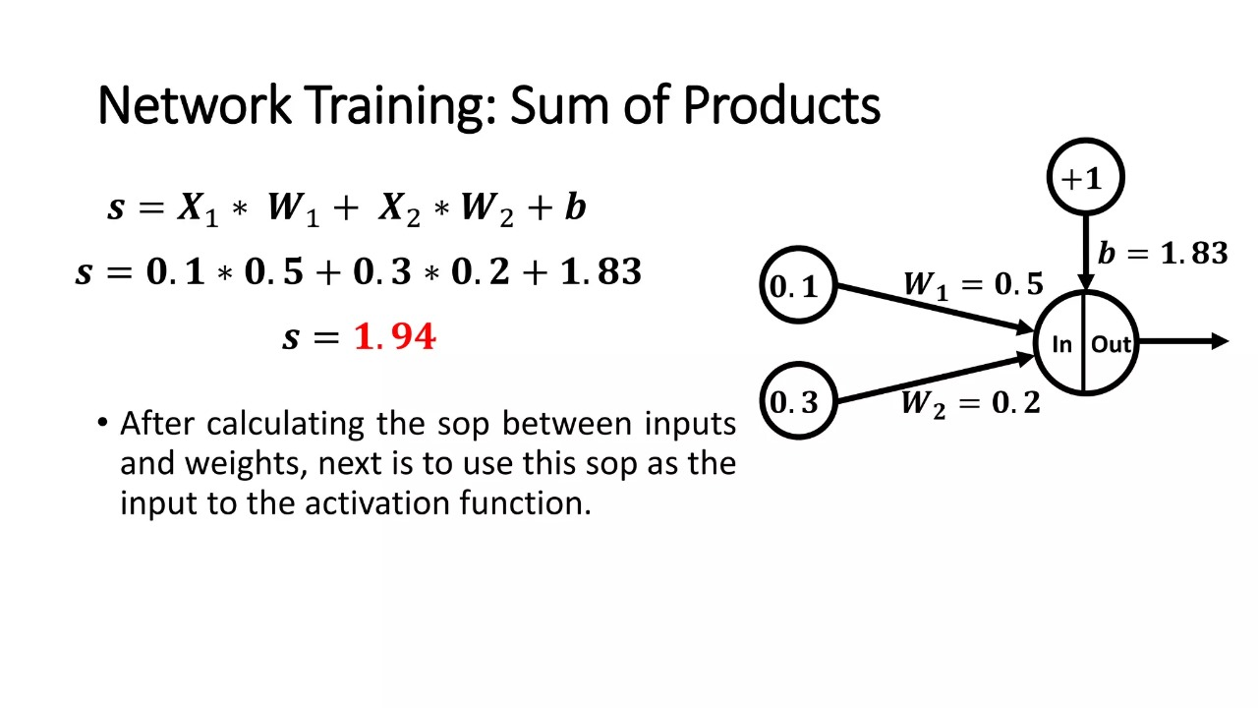

Slide 41
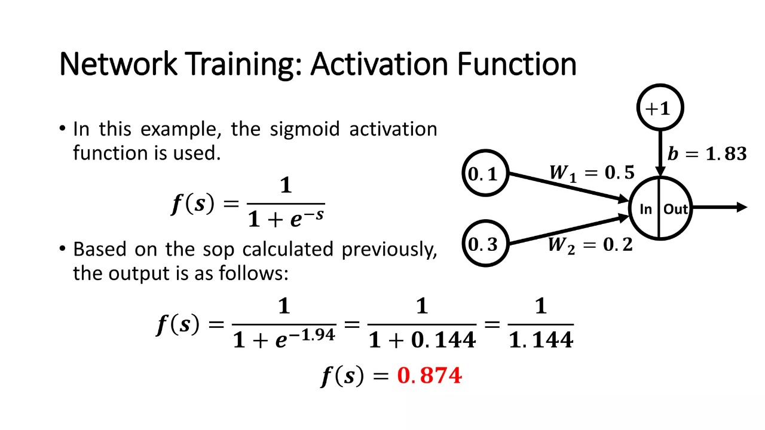

Slide 42
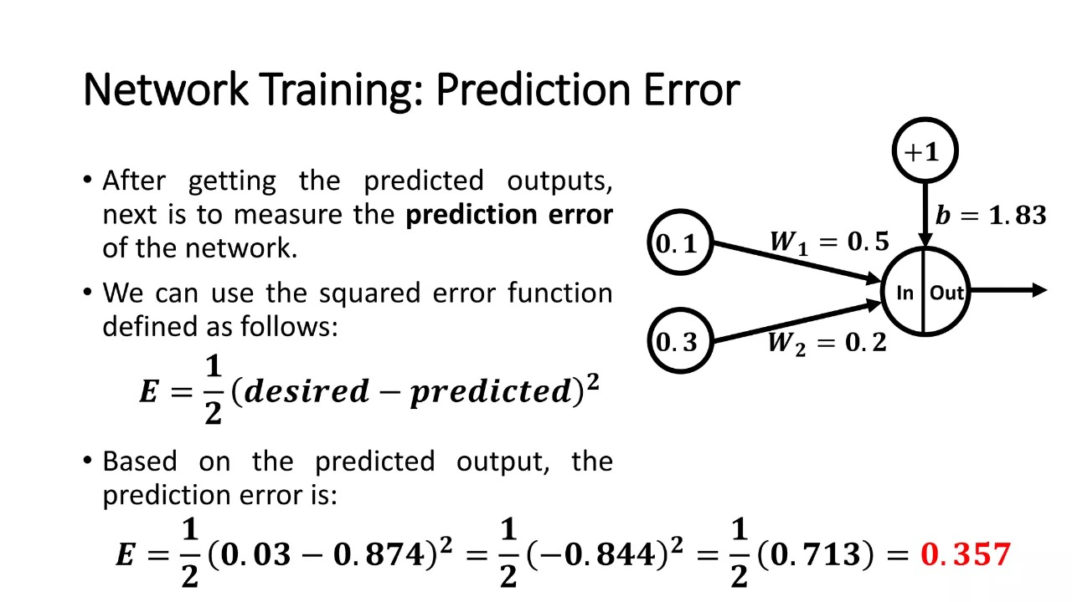

Slide 43
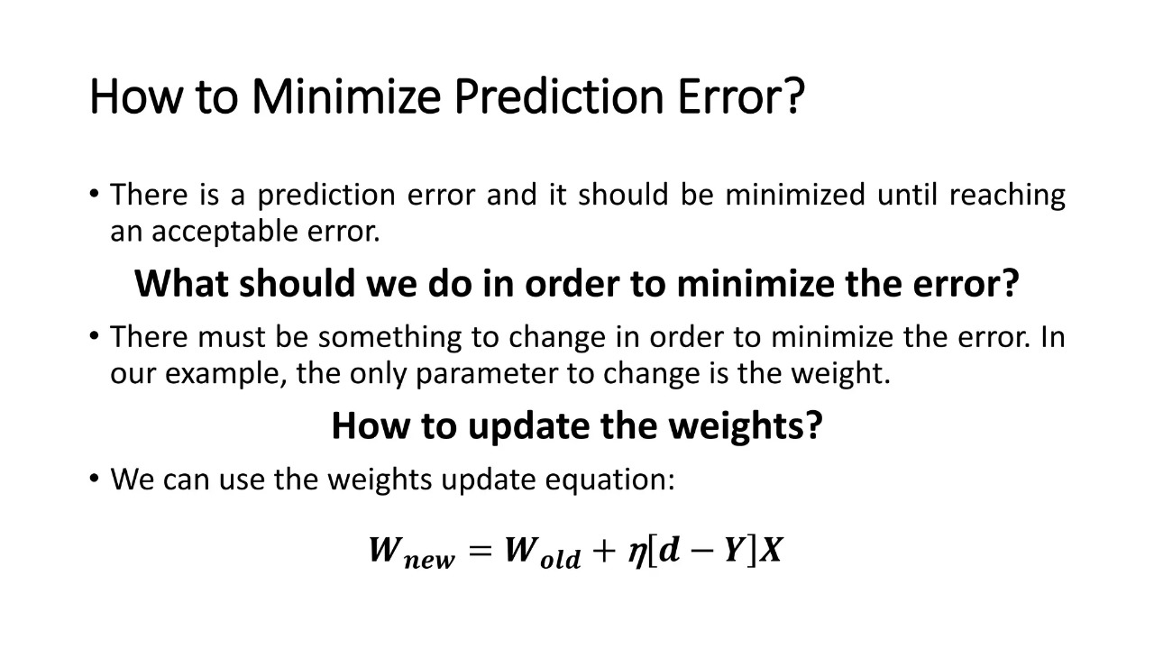

Slide 44
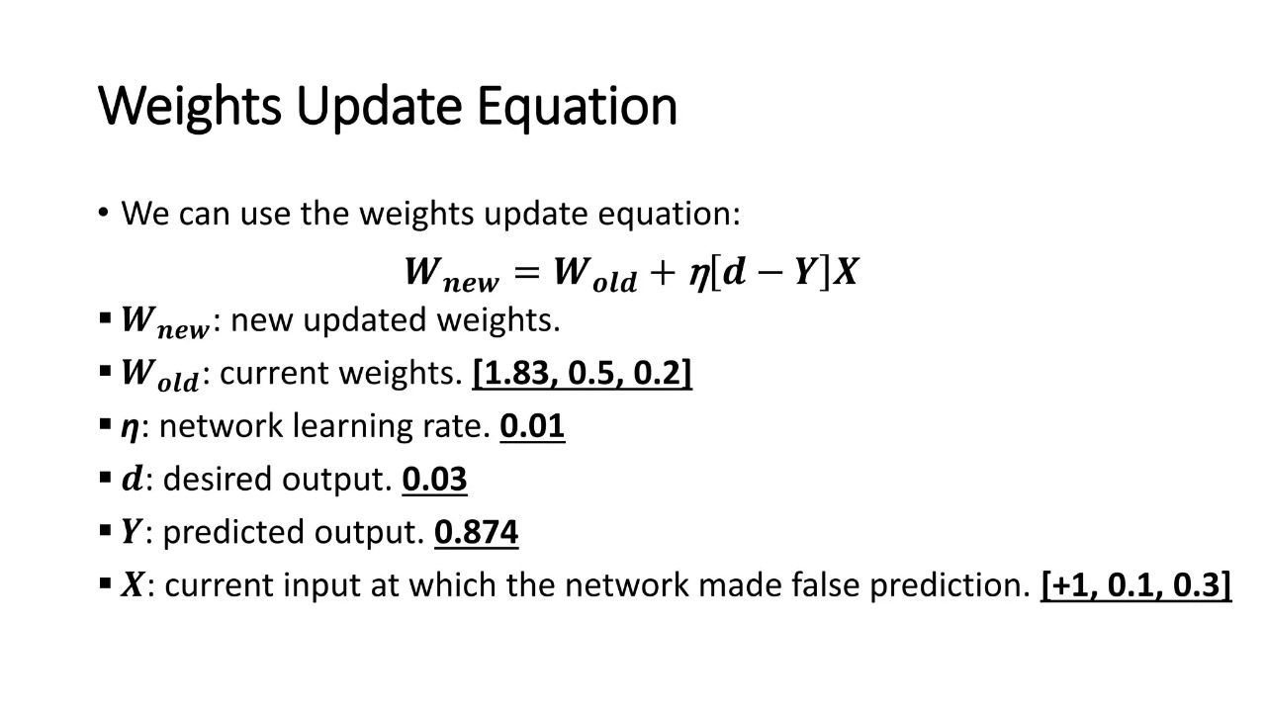

Slide 45
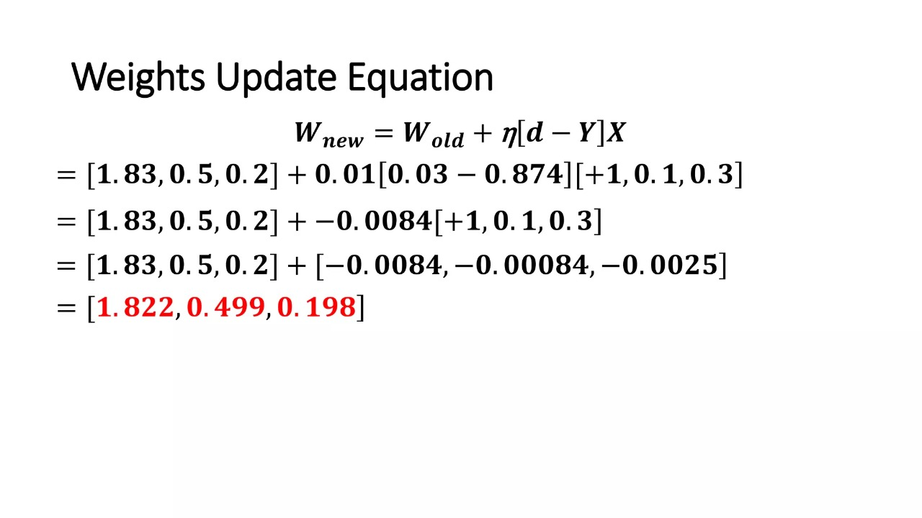

Slide 46
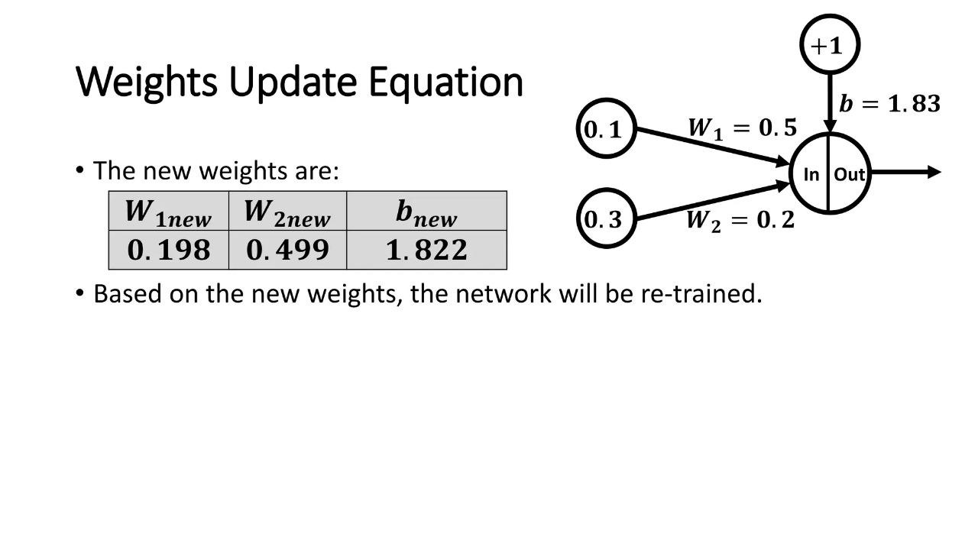

Slide 47
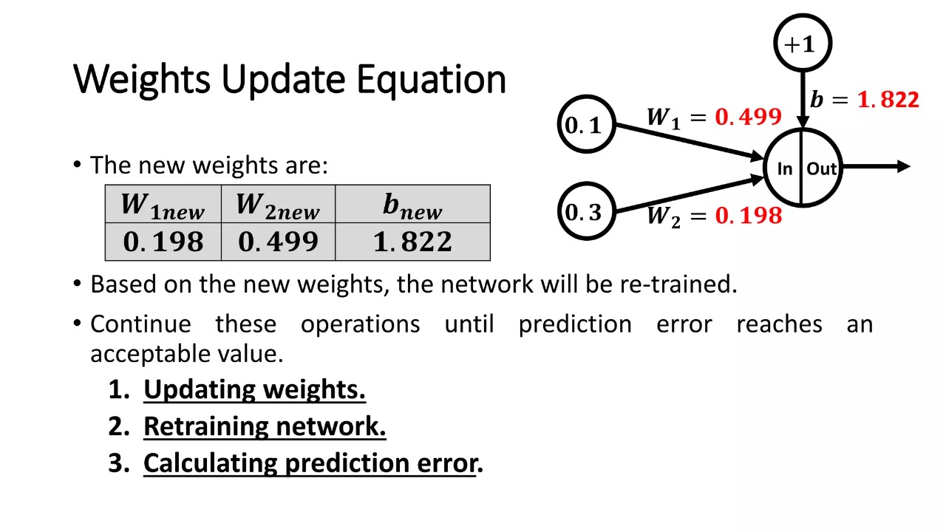

Slide 48
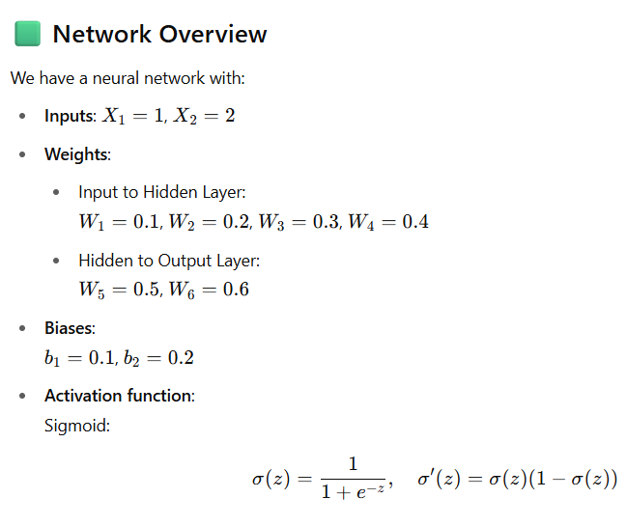
b1 =0.1
X1 = 1
W1 = 0.1
Z1|A1
W5 = 0.5
W2 = 0.2
Z3|A3
y = 1
W3 = 0.3
X2 = 2
Z2|A2
W6 = 0.6
W4 = 0.4
b2 = 0.2

Slide 49
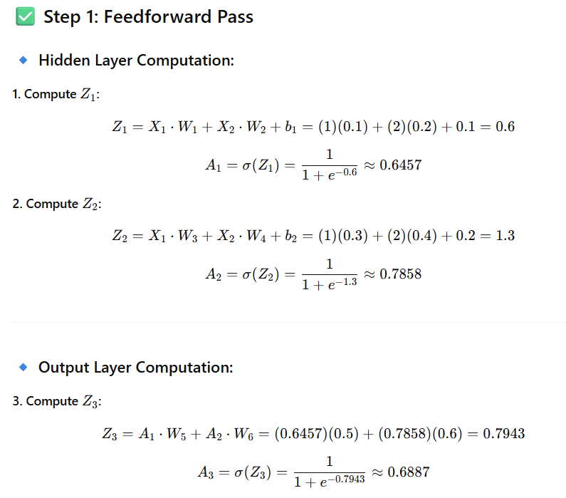

Slide 50
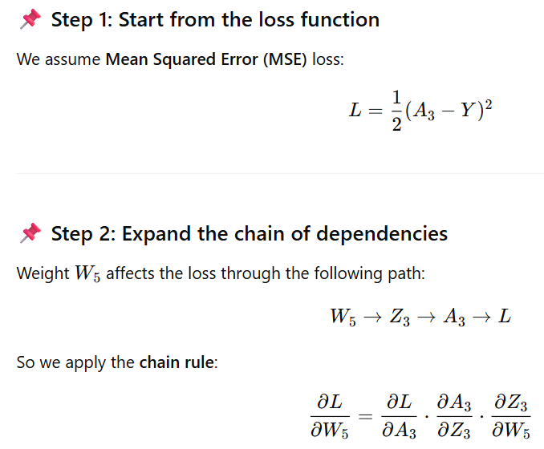

Slide 51
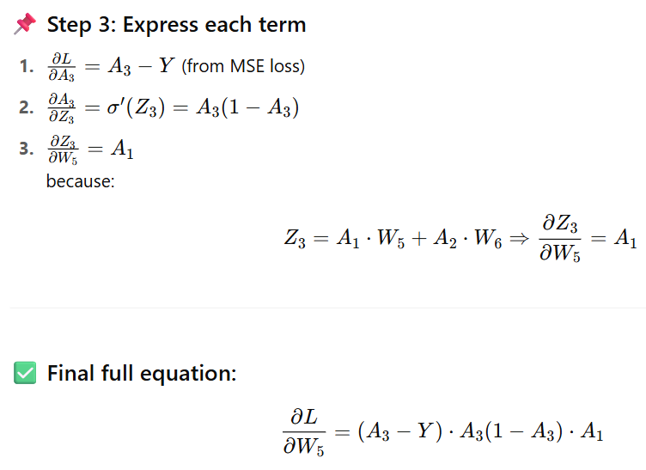

Slide 52
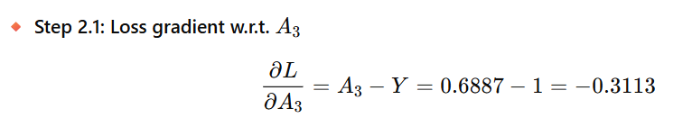
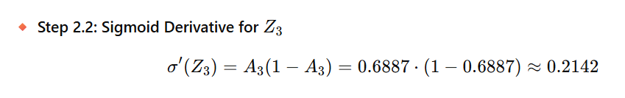



Slide 53



Slide 54



Slide 55



Slide 56


Slide 57

Machine Learning vs Deep Learning

Slide 58
Deep Learning
Several DL models have been proposed :
• Convolutional neural networks (CNNs).
• Autoencoders (Aes).
• Recurrent neural networks (RNNs).
• Generative adversarial networks (GANs).
• Faster RCNN and Mask RCNN.

Slide 59
Evaluation Metrics
Regression

Slide 60

Evaluation Metrics [ Classification ]

